Slide 1

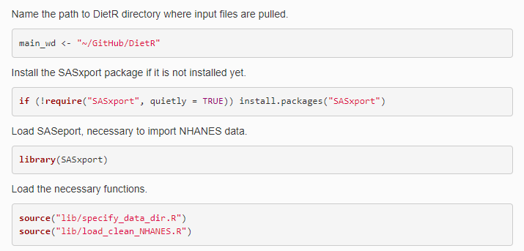
Load and clean NHANES data
Introduction
In this tutorial, we aim to demonstrate the utility of the DietR package by applying it to the dietary data available from the National Health and Nutrition Examination Survey (NHANES).
NHANES is a national survey conducted with some thousands of participants across the US over two days. NHANES data is published every other year and consists of various kinds of data including dietary intake, body measurements, laboratory-taken data. There are numerous questions that can be asked with these data to connect dietary intake with various biomarkers. Here, as an example, we will explore the dietary intake (food items) of participants and look at the relationship between dietary patterns and diabetic status in NHANES 2015-2016.
Refer to the NHANES data and documentation for more information about each release (version) of NHANES and the variables measured.
Data from NHANES are in .XPT format, and you will need a specific R package, SASxport, to import it into R. We will download the example data files from the NHANES 2015-2016 page and save them in the “Raw_data” folder in the “NHANES” folder.
Open “02_load_clean_NHANES_food_1.R” script (this script) in the “users” folder and load the packages needed as per the directions.
In this script, you will learn how to download datasets and associated other databases from NHANES, how to process that data with DietR, and the food tree to generate dietary patterns, and how to integrate these dietary patterns with other biomarker data from NHANES to explore specific hypotheses.
Load functions and packages
To change the highlighted color of your TOC…
<style type="text/css">
.list-group-item.active, .list-group-item.active:focus, .list-group-item.active:hover {
background-color: purple;
}
</style>

Slide 2
